Slide 1
ABC CALL VOLUME TREND ANALYSIS
By Swetha G

Slide 2
OVERVIEW
In the current era, several AI-powered tools are being used to enhance customer experience. These include Interactive Voice Response (IVR), Robotic Process Automation (RPA), Predictive Analytics, and Intelligent Routing.
The world of Customer Experience (CX) analytics, specifically focusing on the inbound calling team of a company.
We are provided with a dataset that spans 23 days and includes various details such as the agent's name and ID, the queue time (how long a customer had to wait before connecting with an agent), the time of the call, the duration of the call, and the call status (whether it was abandoned, answered, or transferred).

Slide 3
PROBLEM DESCRIPTION
Inbound customer support, which is the focus of this project, involves handling incoming calls from existing or prospective customers.
The goal is to attract, engage, and delight customers, turning them into loyal advocates for the business.
To calculate the number of Employees required to reduce the amount of abandoned calls to 10%.

Slide 4
APPROACH
Understand the data set. Check for any missing values in the data. In this dataset there are no missing categorical values.
Use pivot tables to draw inferences according to the tasks given.
Also plot graphs and charts.
To calculate the manpower required to reduce the abandoned calls to 10%, required formulae such as sum(), search(), average() are to be used.

Slide 5
TECK STACK USED
Google Sheets – to use the pivot tables and charts to draw analysis
Google Search Engine – to clarify doubts
YouTube – to clarify doubts

Slide 6
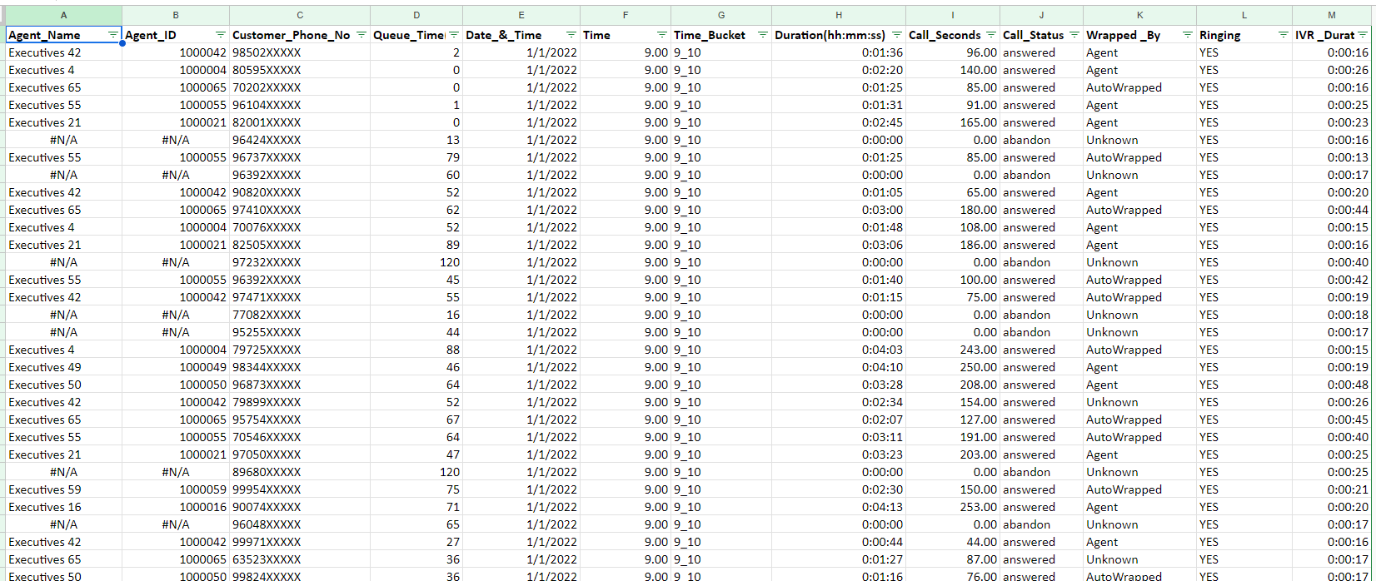
DATA SET

Slide 7
WORKING FILE LINK
https://docs.google.com/spreadsheets/d/1nypOQy7AAI1v_Gi8IBQogwwpXOYLHax1/edit?usp=sharing&ouid=108714204923685218939&rtpof=true&sd=true

Slide 8
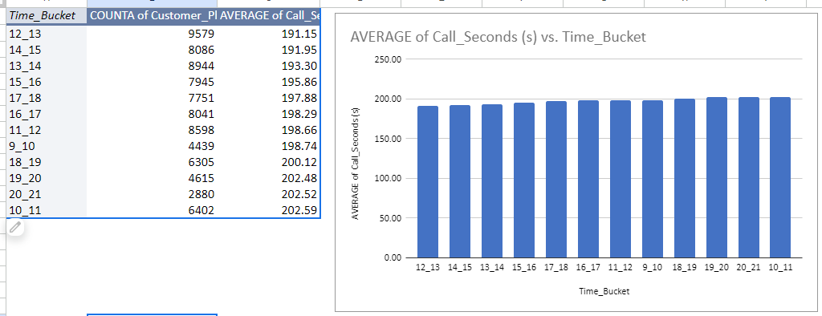
TASK 1
What is the average duration of calls for each time bucket?
The maximum duration (lengthiest) of incoming calls are between 10 am to 11 am
The minimum duration (shortest) of incoming calls are between 12pm to 1 pm

Slide 9
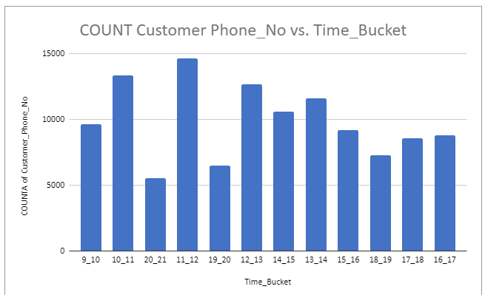
TASK 2
Can you create a chart or graph that shows the number of calls received in each time bucket?
The maximum number of calls (more frequency) are between 11 am to 12 pm
The minimum number of calls (low frequency) are between 8 pm to 9 pm

Slide 10
ASSUMPTION FOR TASK 3
An agent works for 6 days a week; On average, each agent takes 4 unplanned leaves per month;
An agent's total working hours are 9 hours, out of which 1.5 hours are spent on lunch and snacks in the office.
On average, an agent spends 60% of their total actual working hours (i.e., 60% of 7.5 hours) on calls with customers/users. The total number of days in a month is 30.
Agent per day working hours is 4.5

Slide 11
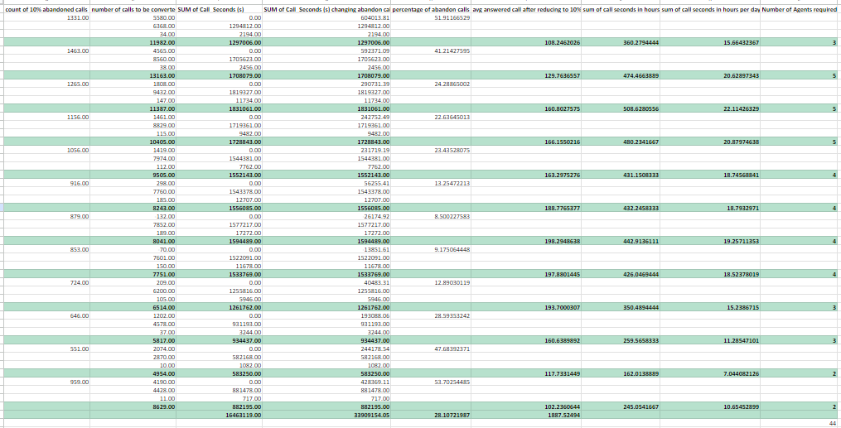
TASK 3
What is the minimum number of agents required in each time bucket to reduce the abandon rate to 10%?
The number of agents required for the day shift are 44

Slide 12
ASSUMPTION FOR TASK 4

Slide 13
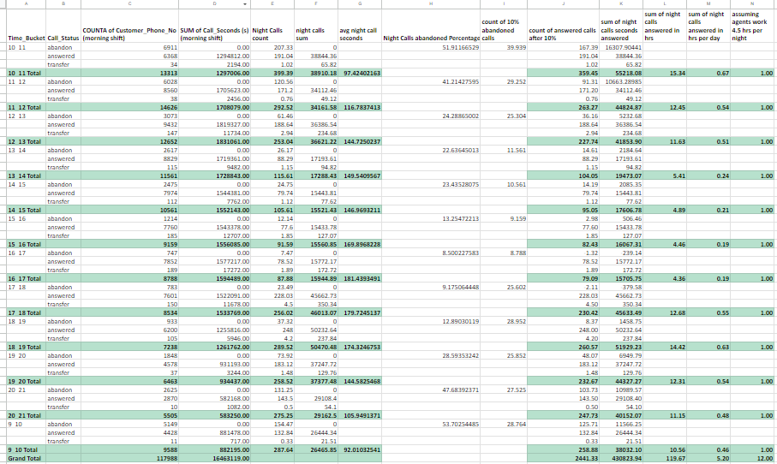
TASK 4
Propose a manpower plan for each time bucket throughout the day, keeping the maximum abandon rate at 10%.
The number of agents required for the night shift are 12

Slide 14
RESULT
The average longest call is between 10 am to 11 am and the average shortest call is between 12 pm to 1 pm
The maximum number of calls is between 11 am to 12 pm and the minimum number of calls are between 8 pm to 9 pm
The number of agents required for morning shift is 44
The number of agents required for night shift are 12

